Slide 1
BIOE 498 / BIOE 599: Computational Systems Biology for Medical Applications CSE 599V: Advancing Biomedical Models Lecture 13: Model Engineering
Joseph L. Hellerstein*
Herbert Sauro**
*eScience Institute, Computer Science & Engineering
**BioEngineering

Slide 2
Notes
Exercise on modularity
Parameters in Tellurium models
Refactoring linear code to a model for reuse
Integrating with differences (e.g., glycolysis in liver vs. muscle)
Readability exercise?
Names
Organize reactions
Example of linter; finding reference before assign
Finding missing reactions for combinatorics
Templates as an alternative
SW Eng and model engineering

Slide 3
Common Complaints About BioMedical Models
Reproducibility
agreement between the results of measurements of the same measurand carried out with same methodology described in the corresponding scientific article
Readability (from software engineering)
how easily code can be read and understood
Reuse
use of existing components to build a new system

Slide 4
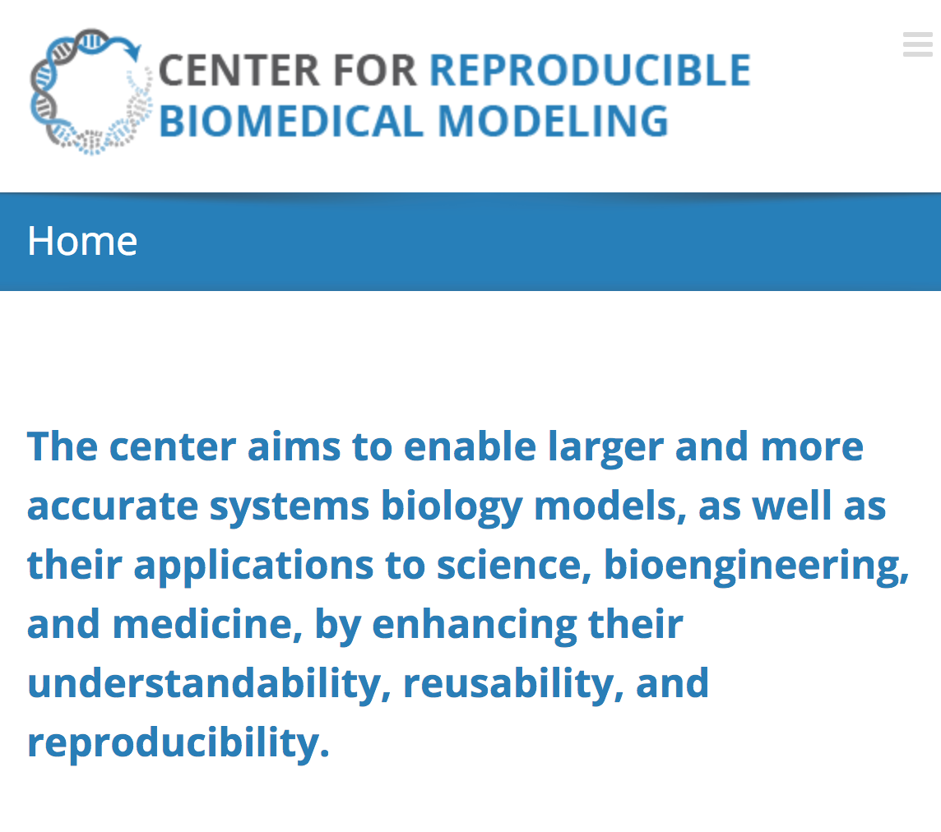

Slide 5
Readability Ouzounoglou2014 - Modeling of alpha-synuclein effects on neuronal homeostasis (#559)
s3 -> s17;
s3 -> s22;
s17 -> s18;
s17 + s22 -> s7;
s17 + s51 -> s78;
s18 -> s521;
s18 + s17 -> s20;
s18 + s51 -> s85;
s20 -> s520;
s20 + s17 -> s24;
…
135 reactions
Difficult to understand model
Species names are not revealing.
Reactions are not organized to facilitate interpretation.

Slide 6
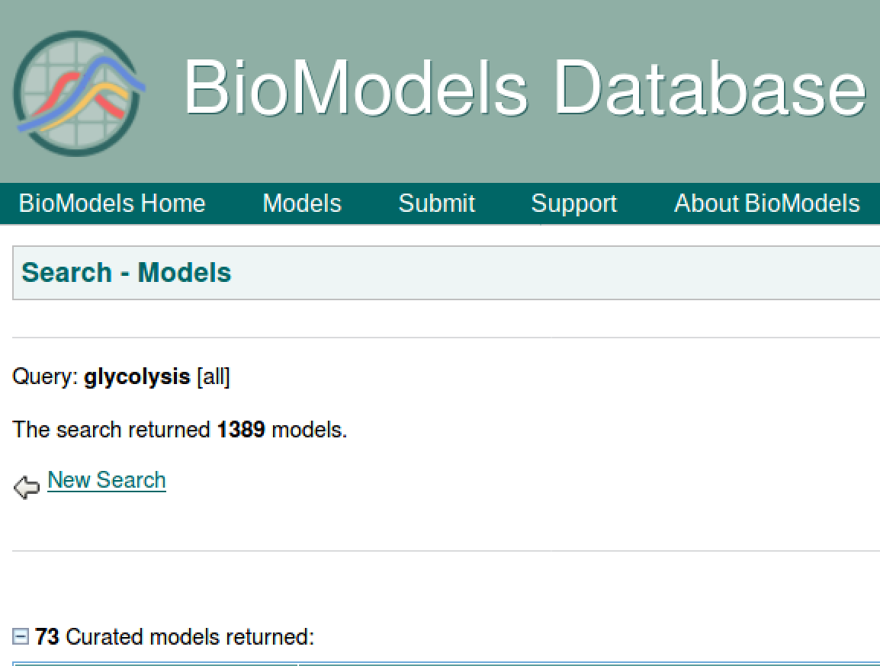
Reuse
Why are there so many models for glycolysis?

Slide 7
Metabolic Pathways in Yeast (Nature

Slide 8
Software Engineering Background
Requirements
Design
Construction

Slide 9

Running Example: Design of ATM

Slide 10
Requirements: What Do We Do With ATMs?
Get cash
Deposit checks
Check balances
These are examples of Use Cases.
Implied use case – User authentication.

Slide 11
Describing a Use Case
What information the user provides
E.g., command entered with its options
What responses the system provides
E.g., prompts, plots, error messages
Authenticate User Use Case
User: Put ATM card in reader
ATM: Display 'Enter PIN'
User: Enters PIN on keyboard
ATM: [if correct] Show main menu
[if incorrect] Display 'Enter PIN'

Slide 12
Use Cases for Models
Build
Validate
Verify
Estimate parameters
Predict

Slide 13
Component Design
Need for modularity and reuse
Model definition and reuse

Slide 14
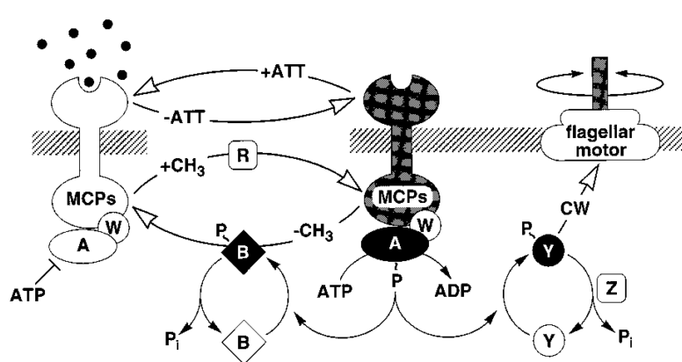
Chemotaxis System (Spiro, 1999)
L
2,3,4
T
p
L - Ligand
p – Inorganic phosphate
2,3,4 – Levels of methylation
Chemotaxis System (Spiro, 1999)
L
2,3,4
T
p
L - Ligand
p – Inorganic phosphate
2,3,4 – Levels of methylation

Slide 15
T -> Tp; kT*T
LT -> LTp; kLT*LT
T2pR -> T3p + R; k*T2pR
T3pR -> T4p + R; k*T3pR
LT2pR -> LT3p + R; k*LT2pR
LT3pR -> LT4p + R; k*LT3pR
T -> Tp
LT -> LTp
T2pR -> T3p + R
T3pR -> T4p + R
LT2pR -> LT3p + R
LT3pR -> LT4p + R

Slide 16
Notes
Rewrite chemotaxis model using model constructs, showing limits.

